Slide 1
Human resources slide 1
Bank Performance Insights: Data-Driven Analysis with Power BI
PRESENTED BY:- Divya Kumari

Slide 2
Human resources slide 9
OBJECTIVE
This report analyzes various banking metrics using Power BI visualizations. The goal is to derive insights into account balances, transaction patterns, customer distribution, and branch performance. This analysis helps to make informed decisions on optimizing operations, improving customer engagement, and enhancing branch profitability.
Key Areas Analyzed:
Total balance across all account types.
Top-performing branches by total account balances
Average balance for branches
Transaction trends over time
Total transacting customers age group
State wise branch performance & top branches with high transactions

Slide 3
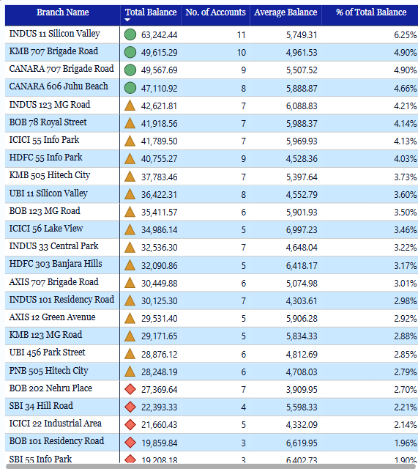
BRANCH PERFORMANCE
Key Insight:
The branch performance analysis highlights that top-performing branches like INDUS 11 Silicon Valley and KMB 707 Brigade Road lead in both total balance and transaction volume, indicating strong customer engagement.
Urban branches, especially in states like Maharashtra, Karnataka, and Telangana, consistently outperform rural ones.
Underperforming present opportunities for improvement. To drive growth, it's recommended to strengthen high-performing branches with additional support, improve customer acquisition through targeted campaigns, and regularly monitor key metrics to optimize performance across locations.
Recommendation:
To drive growth, it's recommended to strengthen high-performing branches with additional support, digital tools.
Launch targeted campaigns to boost new account openings.

Slide 4
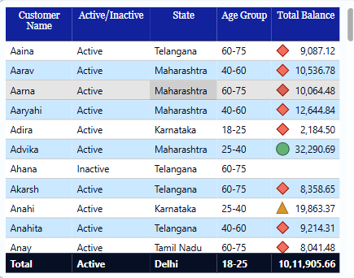
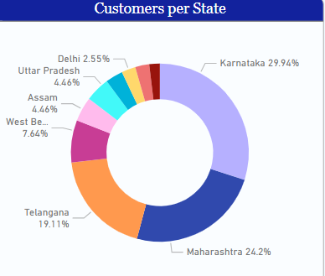
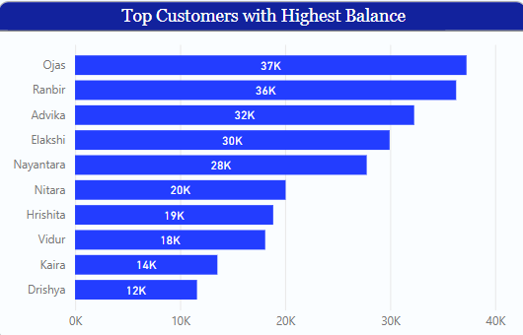
CUSTOMER INSIGHTS
Key Insight:
State-wise Distribution: Karnataka (29.94%) and Maharashtra (24.2%) have the highest customer share making them key regions for business growth.
Majority of customers fall within the 60–75+ age group, highlighting an older, mature customer base.
Strong link between high balance and high transaction volume.
Recommendation:
Engage high-value customers with loyalty programs or premium services.
Target younger segments (18–40 age groups) to diversify the customer base and ensure future growth.
Follow up on inactive customers to understand reasons and attempt reactivation.

Slide 5
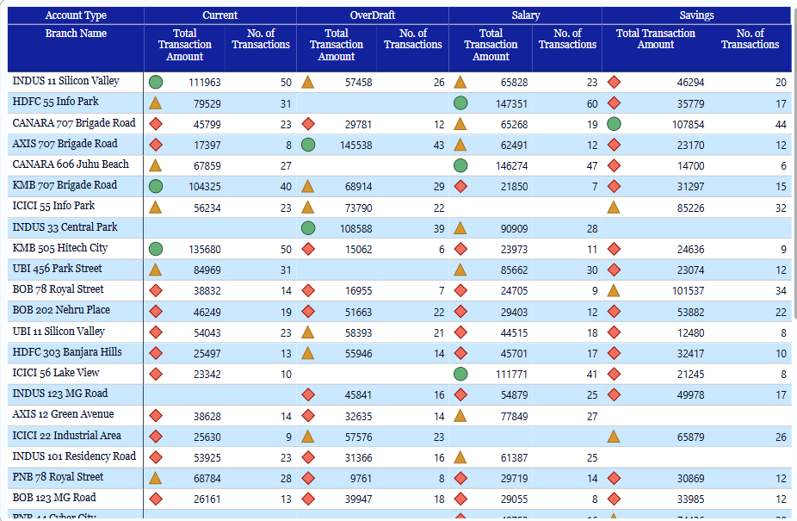
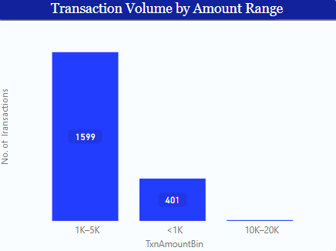
Transaction Overview
Key Insight:
Monthly trend shows peak transaction amount in September with fluctuations throughout the year.
Majority of transactions fall in the ₹1K–₹5K range, indicating frequent low-value activity.
Strong transaction activity observed in a few key branches across all account types.
Recommendation:
Implement targeted campaigns around high-activity months like September to boost transactions.
Encourage mid-to-high value transactions through incentives or bundled services.

Slide 6
Human resources slide 10
Thank You

